Slide 1


Under Supervision Mr. MOHIT SAXENA
My Academy
Name of Students
SNEHA JAISWAL
SMITA SINGH
AKTU Roll Numbers
2100100100171
2100100100170

Slide 2

OUTLINE
INTRODUCTION
OBJECTIVE
System Analysis & Design
Implementation
PROJECT SNAPSHOT
Conclusion
SUMMARY OF RESEARCH PAPERS
THANK YOU

Slide 3
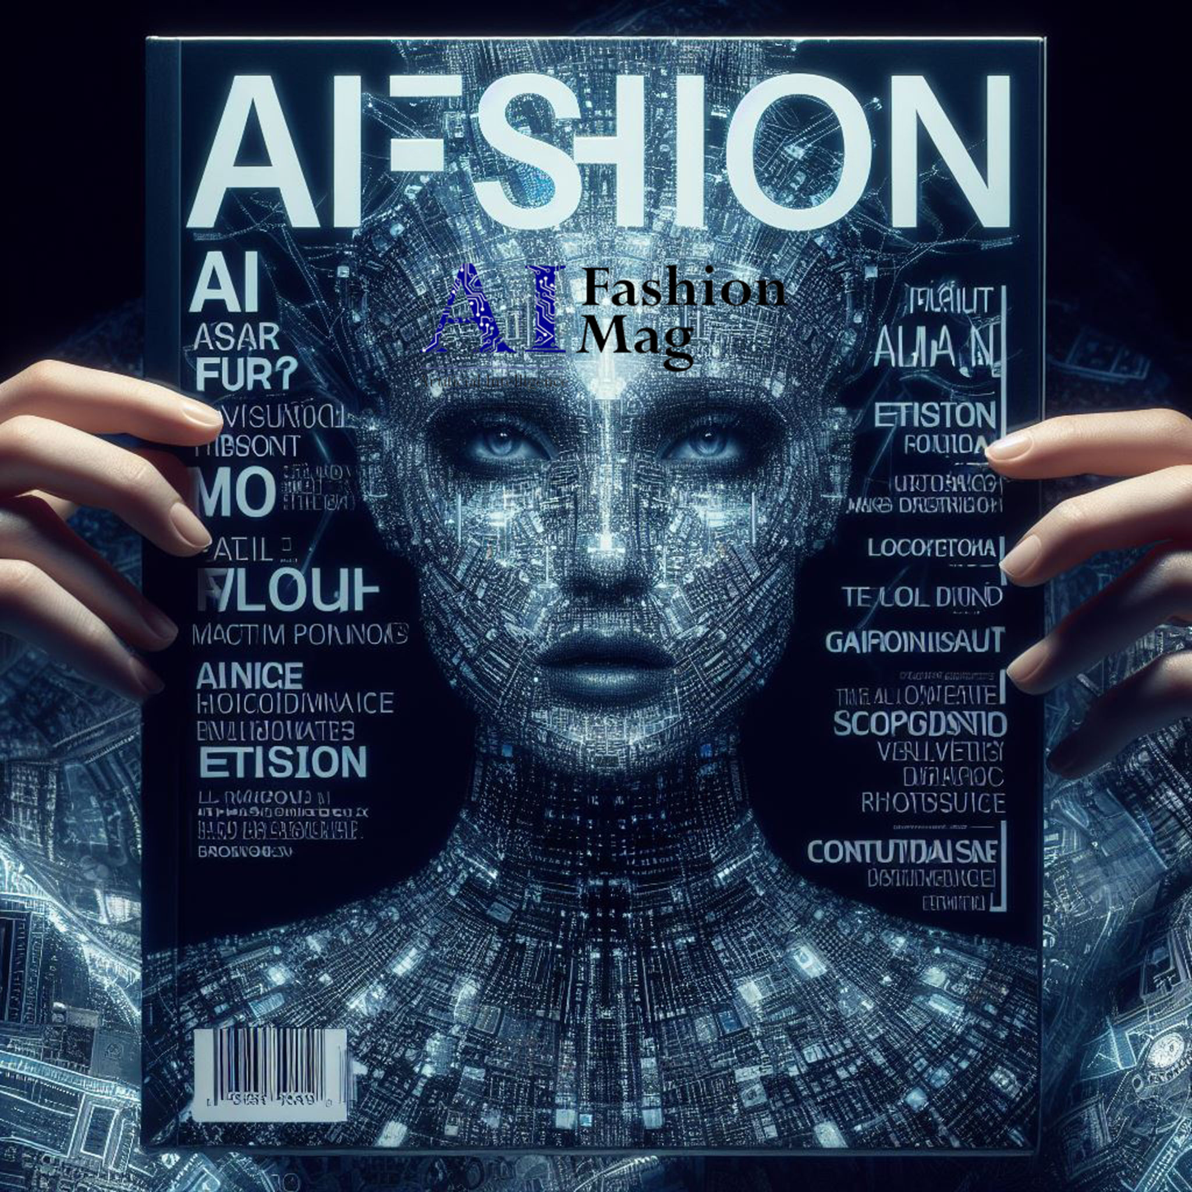
INTRODUCTION
The fashion industry is characterized by its rapid pace and ever-changing trends.
Conventional approaches to trend generation and demand forecasting often prove inadequate, resulting in excess production and missed market opportunities.
Our initiative employs artificial intelligence to create fashion trends and ML for precisely estimate trend demand.
Through data analysis and identification of emerging patterns, our system provides tailored fashion suggestions and crucial insights for retailers.
This approach not only facilitates well-informed decision-making but also promotes a more sustainable fashion ecosystem.

Slide 4
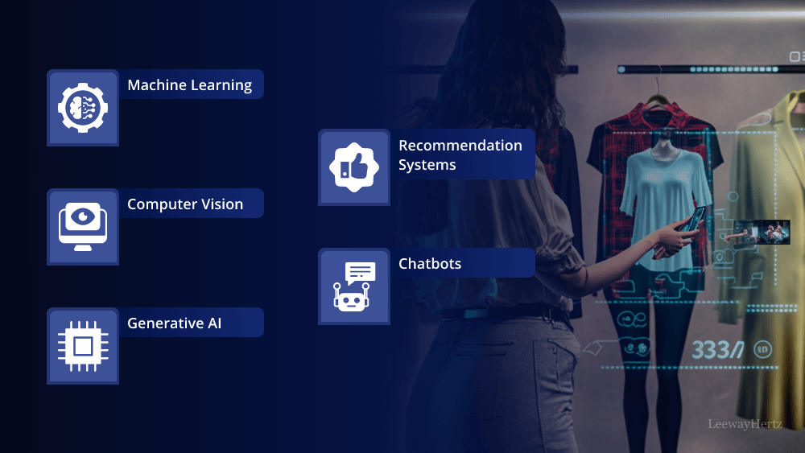
OBJECTIVE
We aim to create an artificial intelligence & machine learning-driven online platform that identifies and predicts fashion trends by examining historical information, social media content, and industry reports.
This system will precisely estimate the popularity of different clothing designs, assisting companies in managing their stock and minimizing excess inventory.
Furthermore, it will provide customized style suggestions to consumers, improving their shopping journey by connecting them with current fashion trends.
Through the incorporation of machine learning technology, we intend to streamline trend analysis and deliver up-to-the-minute insights, allowing businesses to make well-informed choices and maintain a competitive edge in the dynamic fashion industry.

Slide 5
System Analysis & Design
System analysis and design are crucial stages in the creation of any software ap-plication because they determine how the system operates, how the users will en-gage with it, and through which components data streams. This chapter presentsan extensive analysis and design for the suggested system, which includes func-tionalities like demand forecasting, educational content, event news, and chatbotcommunication.
To model the internal structure and external interactions of the system, mod-eling tools like Use Case Diagram, Data Flow Diagram (DFD), System Flowchart,and Entity-Relationship (ER) Diagram are employed. These modeling tools as-sist in visualizing system behavior, determining user roles, charting processes, anddefining the relationships between various data entities.

Slide 6
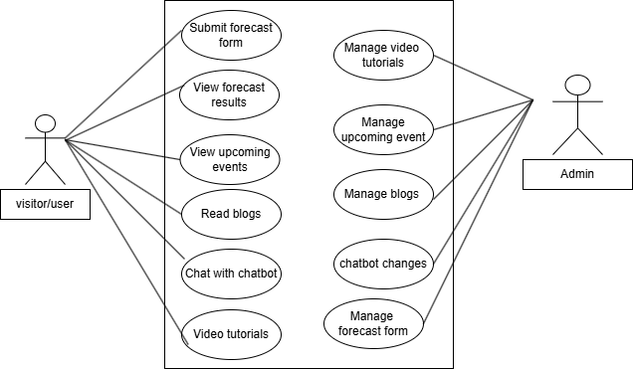
Usecase DIAGRAM

Slide 7
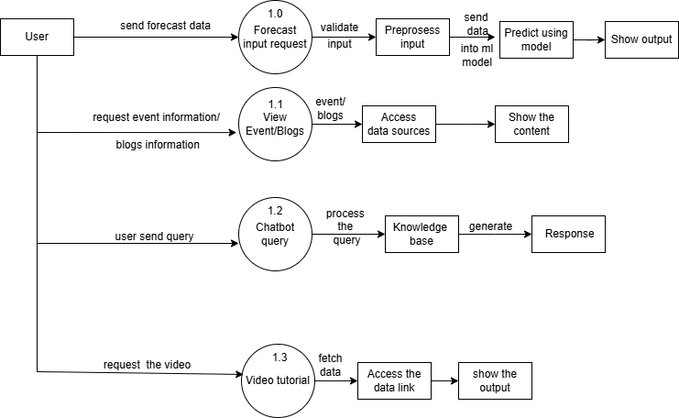
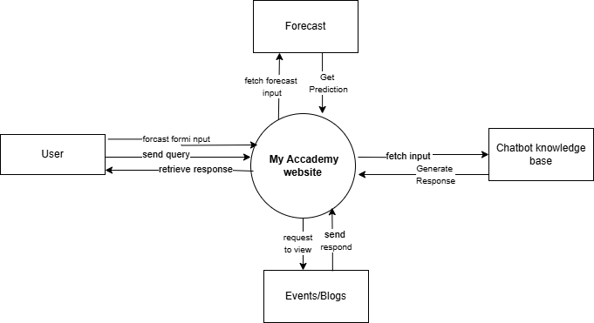
DATA FLOW DIAGRAM
Level 0
Level 1

Slide 8
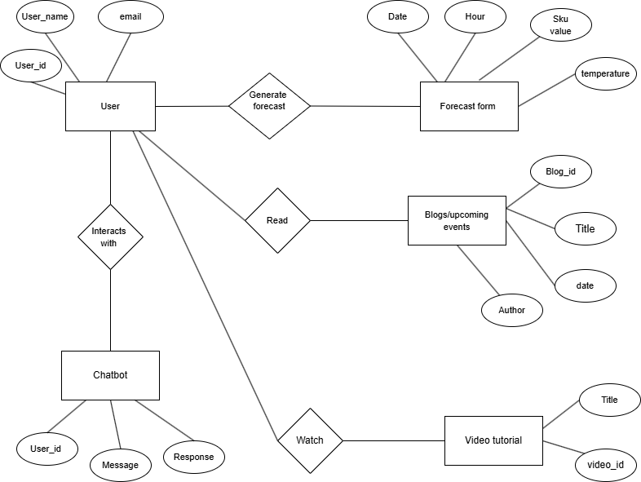
ER DIAGRAM

Slide 9
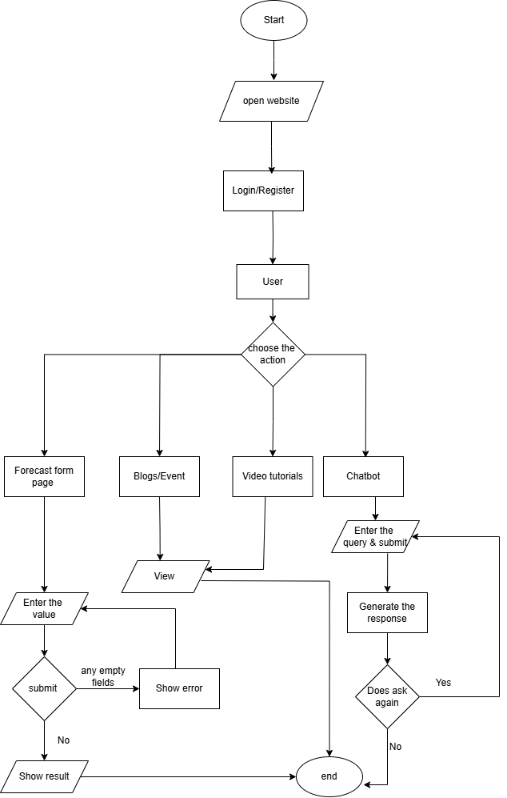
Flow Chart Diagram

Slide 10
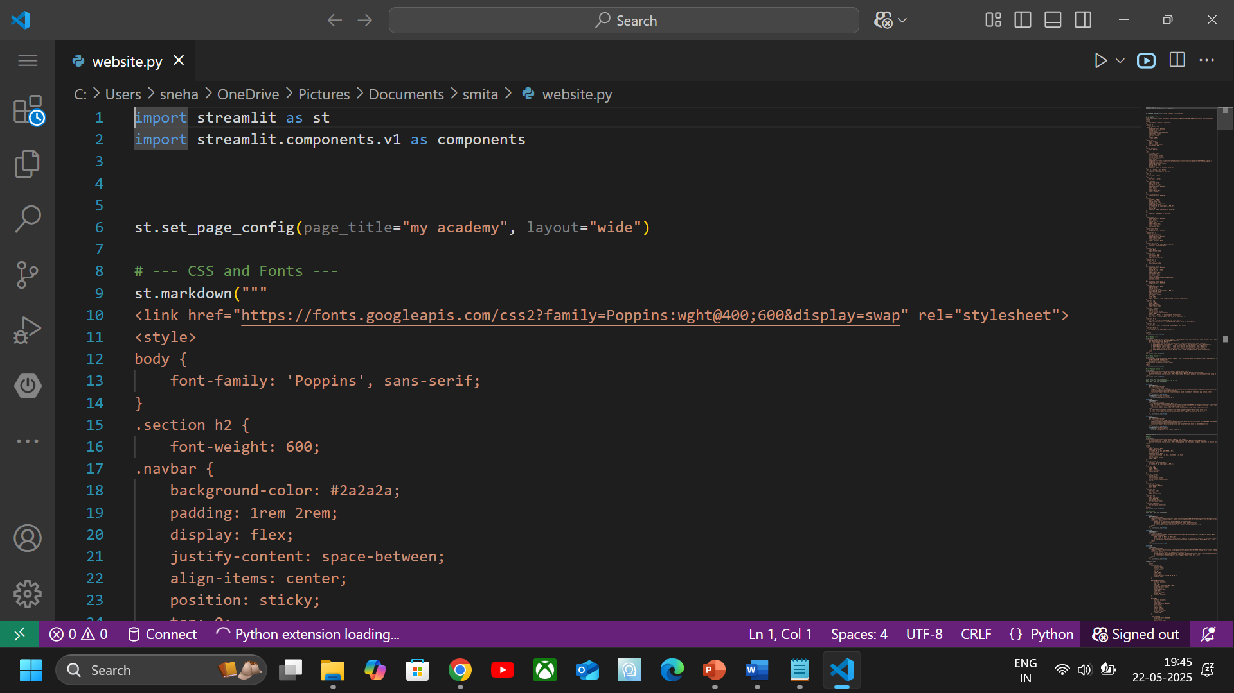
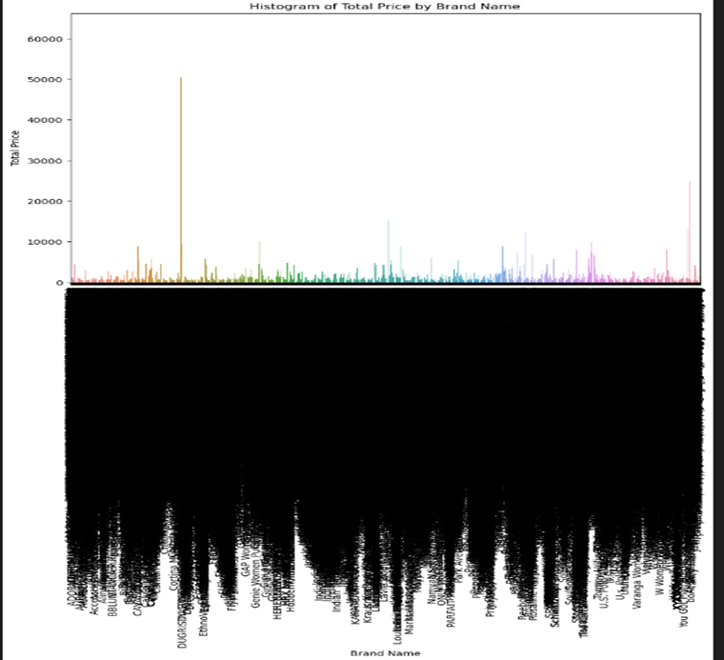
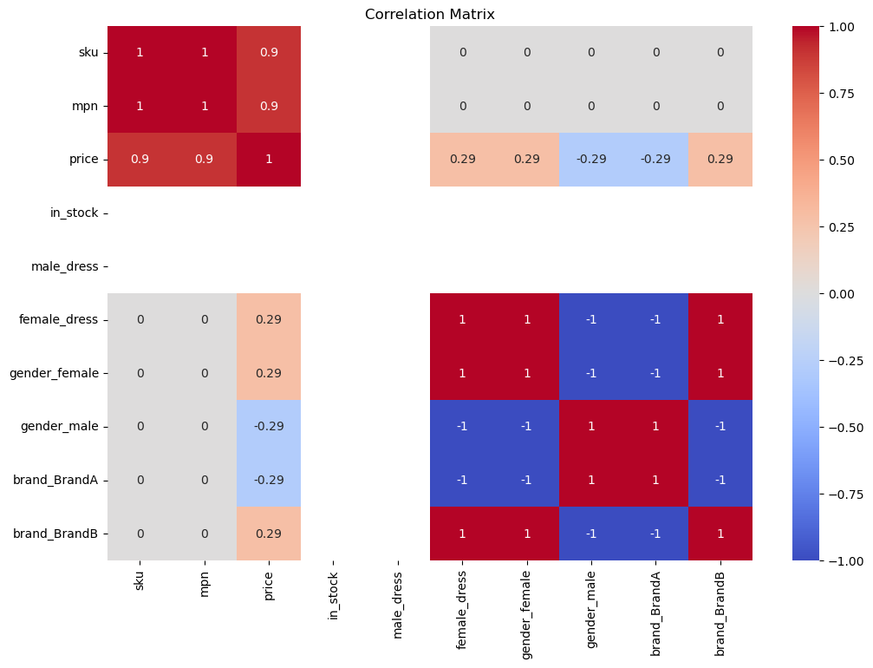
Implementation
Tech Stack Used-
List and briefly describe the technologies used:
Frontend: Streamlit (Python-based UI framework)
Backend: Python
ML Algorithms: XGBoost, Random Forest (for demand forecasting), HistGradientBoosting
Visualization: Chart.js or Matplotlib/Plotly (used for plotting demand graphs)
Data Handling: Pandas, NumPy
Model Training: Jupyter Notebook, Scikit-learn
Deployment: Streamlit Web App
Code

Slide 11
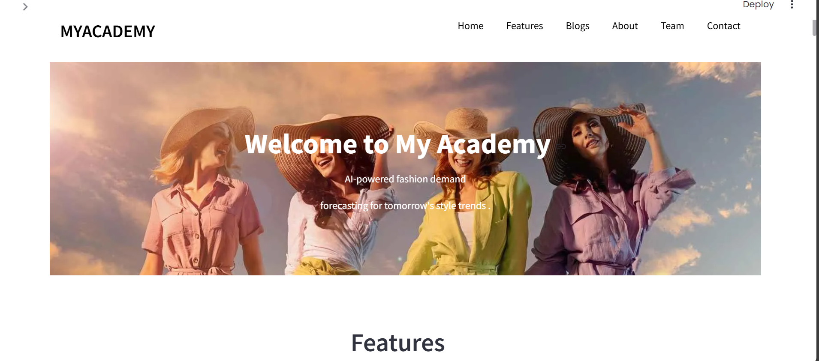
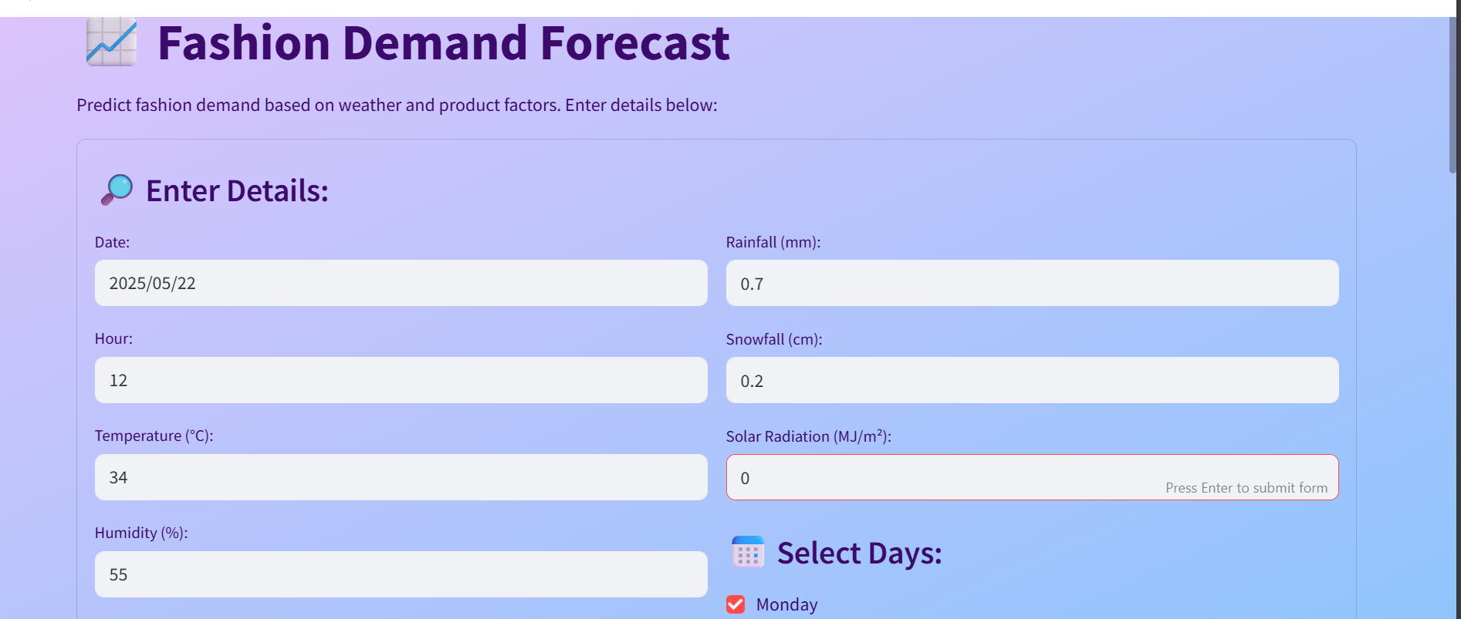
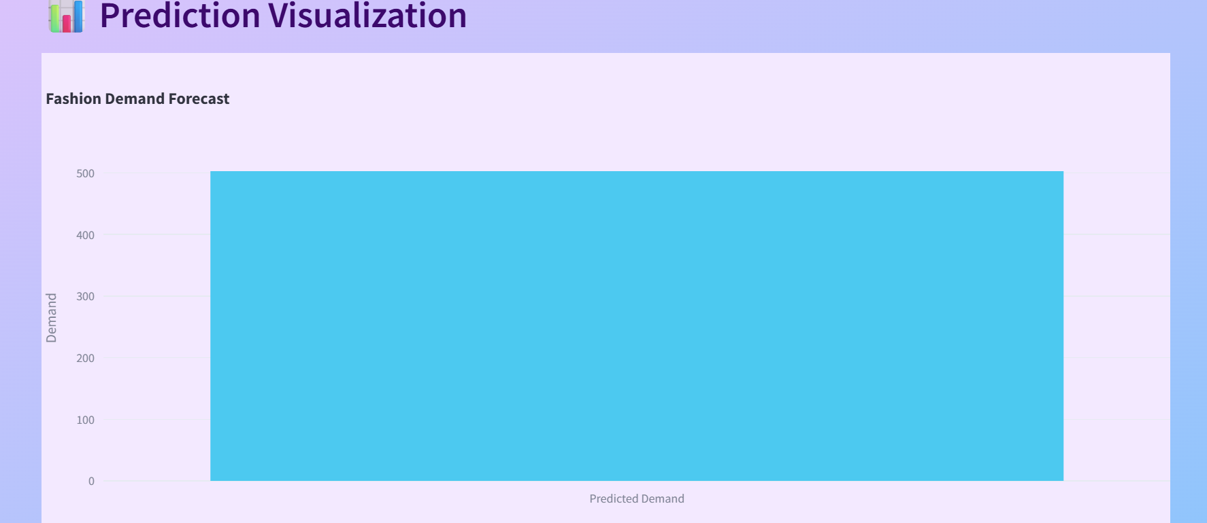
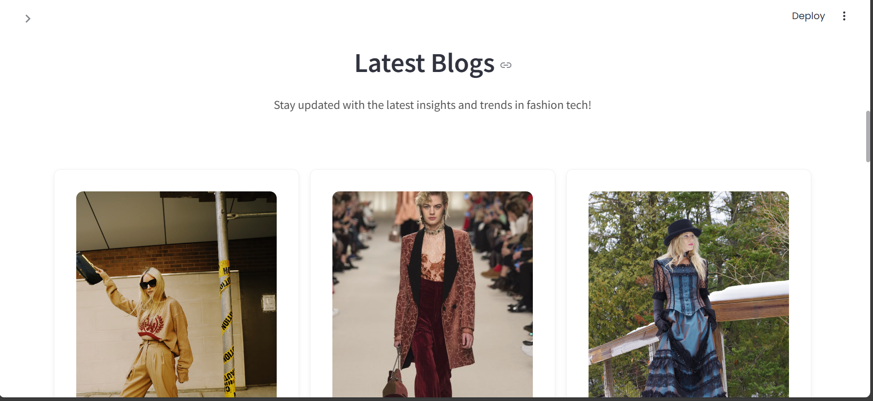
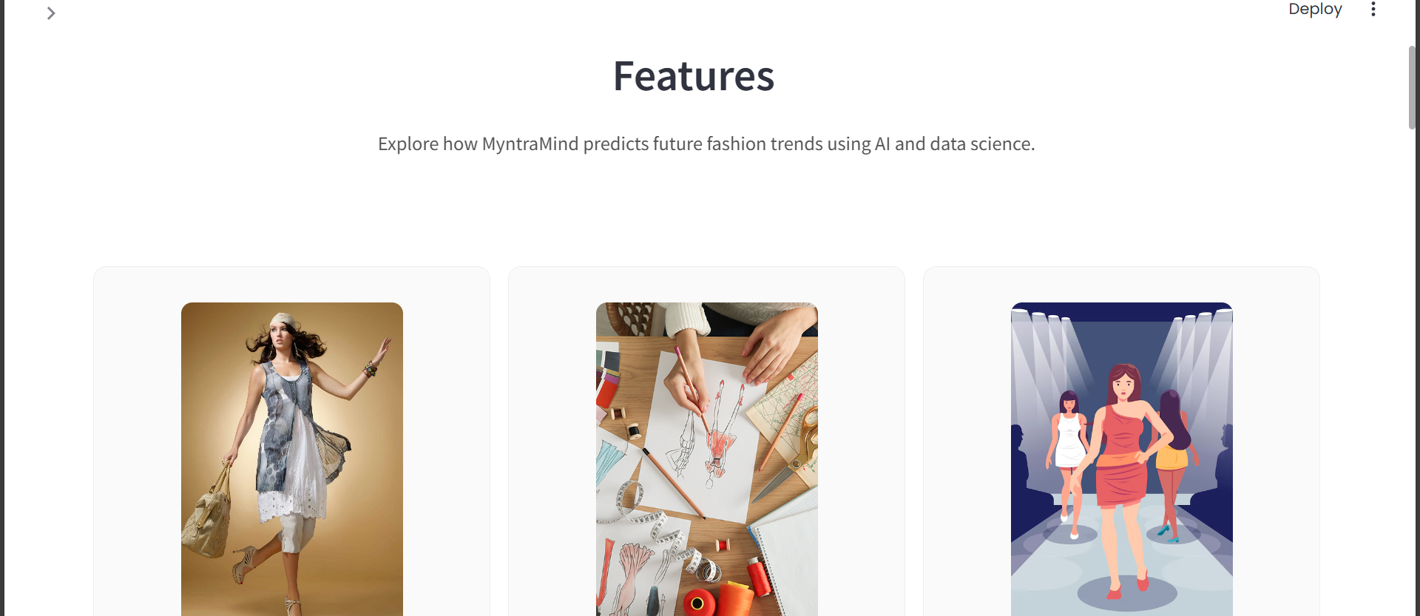
PROJECT SNAPSHOT

Slide 12
Conclusion
The project "My Academy" is a simple and useful platform for predicting fashion demand and trends.
It uses Streamlit, Python, and HTML/CSS to make it user-friendly.
Helps users like retailers and students understand fashion data easily.
A video demo is added to show how the platform works in real-time.
Recommendations for future improvements:
• Integrate video feedback in the Ramp Walk Tutor using webcam support forreal-time correction.
• Add multilingual support to cater to diverse user groups across India andbeyond.
• Improve Fashion Bot training with more datasets, including trending globalfashion feeds.
• Enable chat-based designer consultations or bookings via integrated messag-ing.
• Deploy the platform as a progressive web app (PWA) to improve mobileaccess and offline use.

Slide 13
SUMMARY OF RESEARCH PAPERS
This research endeavor centered on utilizing artificial intelligence and ml for trend demand forecasting and trend generation.
Conventional forecasting techniques struggle with predicting demand for novel products due to the absence of historical data.
The study employs machine learning methodologies, including tree-based algorithms and neural networks like XGBoost and LSTM, to precisely forecast demand by examining crucial attributes and variables. Furthermore, AI-powered trend generation utilizes methods such as natural language processing and deep learning to analyze extensive datasets, identifying emerging trends through the examination of consumer behavior, social media activity, and search patterns.
The combination of these approaches provides retailers with a robust tool to synchronize their inventory with future market trends, enhancing sales prediction accuracy and inventory control.
References https://arxiv.org/abs/2408.08907, https://arxiv.org/abs/2005.00986, http://worldcomp-proceedings.com/proc/p2014/ICA3588.pdf, https://ieeexplore.ieee.org/abstract/document/10223039, https://dl.acm.org/doi/pdf/10.1145/3447239, https://arxiv.org/pdf/1907.01960,

Slide 14
THANK YOU

